Slide 1

Git Workshop
Presented to you by: Derrick Bakhuis
Big Data Engineer @ Blue Base BV
Bluebasesolutions.com

Slide 2
Agenda
History of Git versioning
Best practices
CI/CD in a nutshell
Demo
Getting started with Git
QnA
References

Slide 3
git . history
Git is software for tracking changes in any set of files, usually for coordinating work among programmers collaboratively developing source code during software development. (Wikipedia)
Original Author – Linus Torvalds in 2005
Git has the following features:
Git is a versioning control system, enabling management of software projects
Git is distributed, facilitating collaboration between developers
Git is free and open-source
Git has a tiny footprint and is very fast

Slide 4
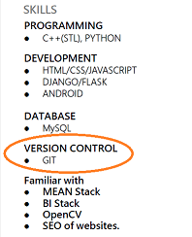
git . popularity
Being able to work with Git versioning is a great skill to have
Most medior and almost all senior roles require familiarity with Git versioning
Platforms of choice:
GitHub
GitLab
Azure DevOps
BitBucket
AWS CodeCommit

Slide 5
Best Practices
Choose a proven way-of-working, i.e.:
Git Flow: most popular, used in large projects
GitHub Flow: simpler to work with, easy to integrate CI/CD
GitLab Flow: more complex, used in combination with testing
If you are starting out with Git I'd strongly recommend you get acquainted with the GitHub Flow

Slide 6
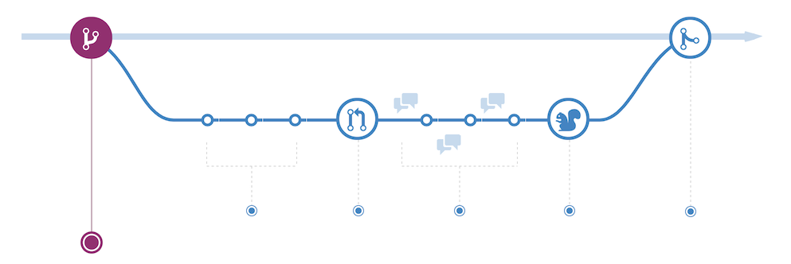
Create feature branch
Make changes
Create Pull Request (PR)
Review
Merge Pull Request (PR)
Delete feature branch
Repeat.
GitHub flow

Slide 7
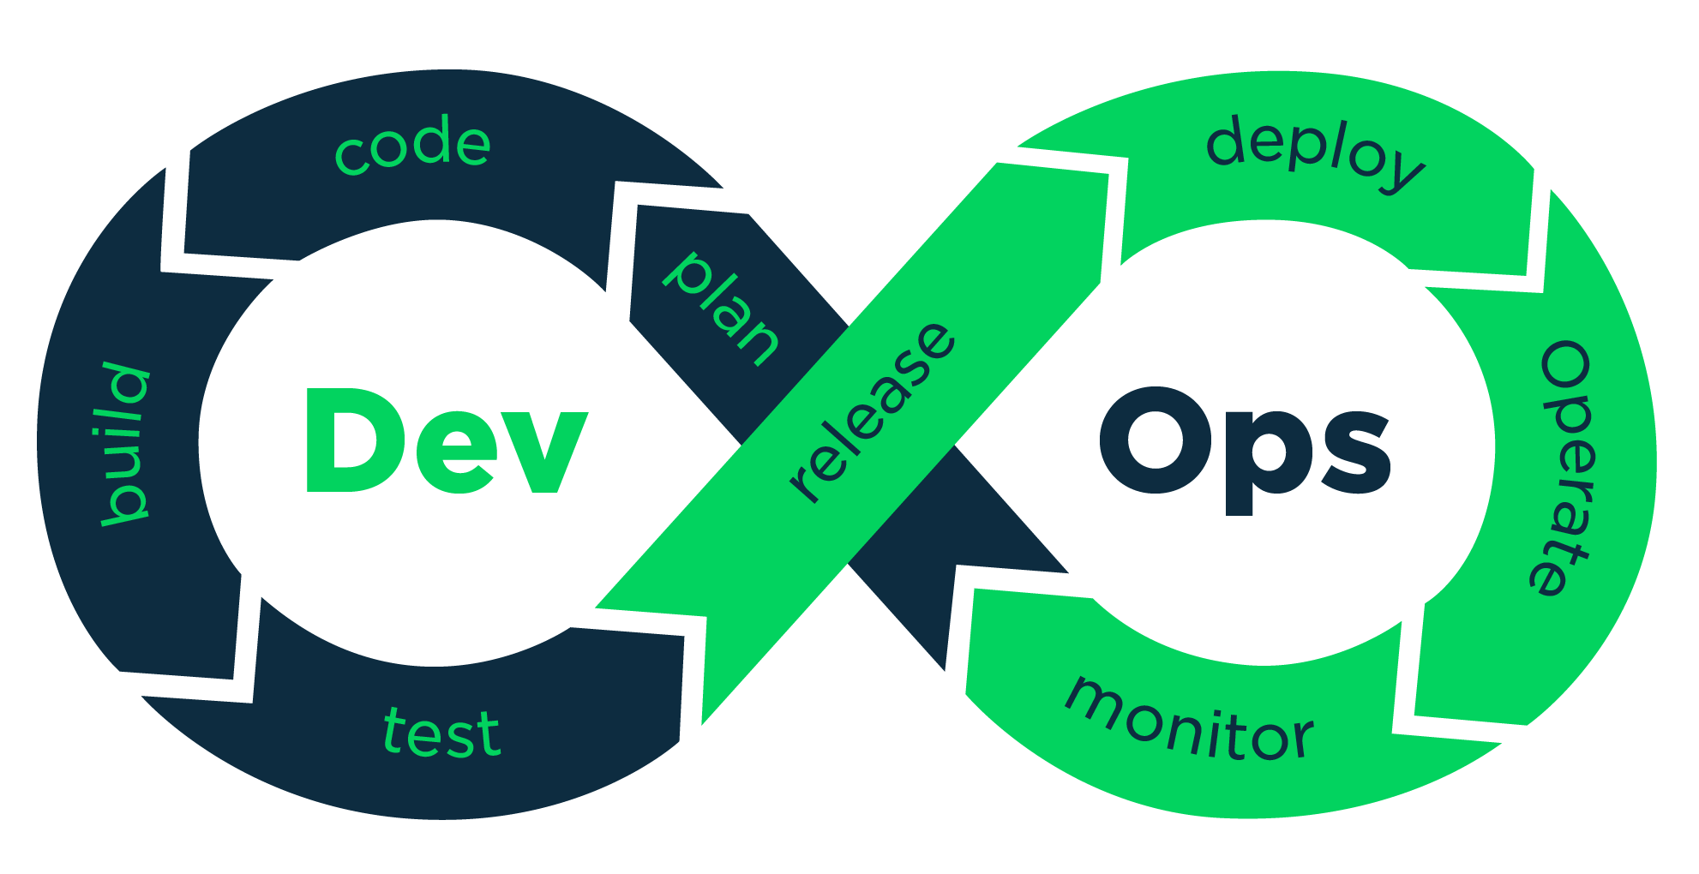
DevOps, CI/CD in a nutshell

Slide 8






CI/CD with the GitHub flow
V1.0
V1.1
main
copy
Pull Request (PR)
feature
deployment
changes/commits
deployment
Develop
Test
Production
deployment
Acceptance

Slide 9
Demo
Link

Slide 10
Getting Started with Git
Code editor:
Visual Code (My personal preference)
Atom
Sublime Text
Git installation
Mac OS installed default. Run the following command in your terminal:
git –version
Windows Git SCM needs to be installed from git-scm.com
Install default settings
If this is your first time working with Git and/or GitHub I'd recommend you start working with GitHub Desktop.
A simple program used to manage your repository
Available via https://desktop.github.com/

Slide 11


Slide 12
References
4 branching workflows for Git
Getting Started installing Git
GitHub Flow
Git Tutorial and Cheatsheet

